Slide 1
Unit -5. Angular
Advanced Web Technology
Dept. of Computer Engineering

Slide 2

Introduction
Angular is an application-design framework and development platform for creating efficient and sophisticated single-page apps.
Angular is a development platform, built on TypeScript. As a platform, Angular includes:
A component-based framework for building scalable web applications
A collection of well-integrated libraries that cover a wide variety of features, including routing, forms management, client-server communication, and more
A suite of developer tools to help you develop, build, test, and update your code
Software Requirement:
Installation:
npm install -g @angular/cli
Create a workspace and initial application:
ng new my-app
Run the application:
ng serve - -open

Slide 3
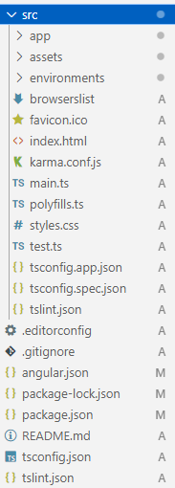
Introduction
TypeScript: TypeScript is a superset of JavaScript. It means that any valid JavaScript code is also valid TypeScript code.
TypeScript is a language that extends JavaScript with static typing and additional features. Angular is a web framework that uses TypeScript as its primary language.
File-Structure:

Slide 4
Databinding and Interpolation
Communication between typescript and html template
There are four main forms of data binding in Angular
String Interpolation
( {{ variable }} )
Property Binding
( [property] = “data” )
Event Binding
( (event)=“methodName” )
Two-way Binding
( [(ngModel)] = “data” )
Template (HTML)
Typescript Code

Slide 5
String Interpolation
Interpolation refers to embedding expressions into marked up text. By default, interpolation uses as its delimiter the double curly braces, {{ and }}
For example,
TS
export class AppComponent {
title = ‘DemoProject’;
}
HTML
<h1> {{ title }} </h1>

Slide 6
Property Binding
Property binding in Angular helps you set values for properties of HTML elements or directives.
Property binding moves a value in one direction, from a component's property into a target element property.
For example, <img alt="item" [src]="itemImageUrl">
TS
export class AppComponent {
title = “Marwadi University”;
isdisabled=true;
ngOnInit(){
setTimeout(()=>{
this.isdisabled=“false";
},5000);
} }
HTML
<h1>Welcome to {{ title }}</h1>
<button [disabled]="isdisabled">Update</button>
<!-- <button [style.color]="isdisabled">Update </button> -->

Slide 7
Event Binding
Event binding lets you listen for and respond to user actions such as keystrokes, mouse movements, clicks, and touches.
For example,
<button (click)="onSave()">Save</button>
TS
export class AppComponent {
title = ‘DemoProject’;
value=“ ”;
onSave( ){
window.alert(“Button Clicked!”);
this.value=“Button Clicked!”;
}
}
HTML
<button (click)="onSave()">Save </button>
<br>
<span>{{value}}</span>

Slide 8
Two-way Binding
Two-way binding gives components in your application a way to share data. Use two-way binding to listen for events and update values simultaneously between parent and child components.
Requires:
import {FormsModule} from ‘@angular/forms’;
imports:[BrowserModule, FormsModule]
<input type=”text” [(ngModel)]=”appName”/>
BINDINGS | DETAILS
Property binding | Sets a specific element property.
Event binding | Listens for an element change event.

Slide 9
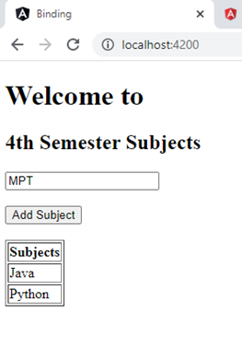
Example - 1
Design a web page to utilize property binding and event binding concepts using button and textbox controls.

Slide 10
Example - 1
Design a web page to utilize property binding and event binding concepts using button and textbox controls.
export class AppComponent {
Sem = "4th Semester";
newSubject = “MPT";
subjectList = ['JAVA’, ‘Python’];
addSubject(){
this.subjectList.push(this.newSubject);
}
}
<h2>{{Sem}} Subjects</h2>
Enter Subject Name:
<input type="text" [(ngModel)]="newSubject"/>
<br>
<button [disabled]="!newSubject" (click)="addSubject()">Add Subject</button>
<br><br>
<span>Your subject is: {{newSubject}}</span>
<br><br>
<table border="1">
<th>Subject Name</th>
<tr *ngFor="let sub of subjectList;">
<td>{{sub}}</td>
</tr></table>

Slide 11
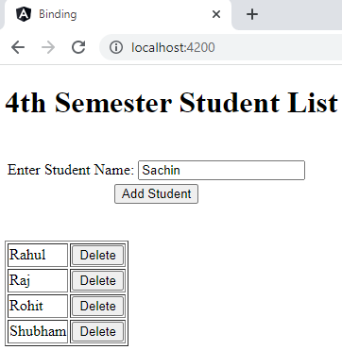
Example - 2
Design component to perform following tasks
To Add or Remove number of students using textbox and button controls and display it in tabular structure format.
Give row level remove button option to student table and record should be deleted when click on it..

Slide 12
Example - 2
HTML
<h1>4th Semester Student List</h1><br>
<table>
<tr>
<td>Enter Student Name:</td>
<td><input type="text“ [(ngModel)]="newStudent“> </td>
</tr>
<tr>
<td align=center colspan="2">
<button [disabled]="!newStudent" (click)="addNewStudent()"> Add Student</button>
</td>
</tr>
</table> <br> <br>
<table border="1">
<tr *ngFor="let stud of studentArray;let i = index">
<td>{{stud}}</td>
<td><button (click)="removeStudent(i)"> Delete</button></td>
</tr> </table>
TS
export class AppComponent {
title = ‘Marwadi University';
newStudent="";
studentArray = ['Rahul','Raj','Rohit'];
addNewStudent(){
this.studentArray.push(this.newStudent);
this.newStudent="";
}
removeStudent(i:any){
if(confirm("Are you sure you want to delete?"))
this.studentArray.splice(i,1);
}
}

Slide 13
Pipe
A pipe takes in data as input and transforms it to a desired output.
We use a pipe with the | syntax in the template, the | character is called the pipe character.
Angular provides some built–in pipes like
lowercase
uppercase
titlecase
slice
number
percent
currency
json
date

Slide 14
Pipe (Example)
HTML
<!-- String Pipes -->
<p>{{'Welcome to ANGULAR' | lowercase}} </p>
<p>{{'Welcome to ANGULAR' | uppercase}} </p>
<p>{{'Welcome to ANGULAR' | titlecase}} </p>
<p>{{'Welcome to ANGULAR' | slice: 5}} </p>
<p>{{'Welcome to ANGULAR' | slice: 5 : 9}} </p>
<!-- Number Pipes -->
<p>{{ 4.76 | number : '1.0-0' }}</p>
number : minIntegerDigits . minFractionDigits – MaxFractionDigits
<p>{{ 0.04 | percent }}</p>
<p>{{ 4.67 | currency }}</p>
<p>{{ 4.67 | currency : 'INR' }}</p>
OUTPUT
welcome to angular
WELCOME TO ANGULAR
Welcome To Angular
me to ANGULAR
me t
5
4%
$4.67
₹4.67

Slide 15
Components and Routing
Generate new component
syntax: ng generate component component_name
ng generate component About
ng generate component Second
ng generate component Home
Above command will create 4 files for each components:
____ . component.html
____. component.spec.ts
____. component.ts
____. component.css

Slide 16
Components and Routing
Add routes for respective pages/components in app.routes.ts
import { Routes } from '@angular/router';
import { HomeComponent } from './home/home.component';
import { AboutComponent } from './about/about.component';
import { ContactComponent } from './contact/contact.component';
export const routes: Routes = [
{path:"", component:HomeComponent},
{path:"about", component:AboutComponent},
{path:"contact", component:ContactComponent}
];
Write below code in app.component.html
<app-header />
<div>
<router-outlet />
</div>
<app-footer />

Slide 17
Components and Routing
Import two components (Header and Footer) in app.components.ts
import { Component } from '@angular/core';
import { RouterOutlet } from '@angular/router';
import { HeaderComponent } from './header/header.component';
import { FooterComponent } from './footer/footer.component';
@Component({
selector: 'app-root',
standalone: true,
imports: [RouterOutlet, HeaderComponent, FooterComponent],
templateUrl: './app.component.html',
styleUrl: './app.component.css'
})
export class AppComponent {
title = 'tc1';
}

Slide 18
Components and Routing
Write below navbar code in in header.components.html
<nav>
<ul>
<li><a routerLink = "">Home</a></li>
<li><a routerLink = "/about">About</a></li>
<li><a routerLink = "/contact">Contact</a></li>
</ul>
</nav>
Import RouterLink in header.components.ts
import { Component } from '@angular/core';
import { RouterLink } from '@angular/router';
@Component({
selector: 'app-header',
standalone: true,
imports: [RouterLink],
templateUrl: './header.component.html',
styleUrl: './header.component.css'
})export class HeaderComponent { }

Slide 19
Components and Routing
Write below navbar code in in footer.components.html
<p>Copyrights CE Dept. Marwadi University</p>
Write below navbar code in in contact.components.html
<div> This is Contact Page. </div>
Write below navbar code in in home.components.html
<div> This is Home Page. </div>

Slide 20
Thank You

